Slide 1





Slide 2
Software Metrics
Software Metrics: What and Why ?
How to measure the size of a software?
How much will it cost to develop a software?
How many bugs can we expect?
When can we stop testing?
When can we release the software?

Slide 3
Software Metrics
What is the complexity of a module?
What is the module strength and coupling?
What is the reliability at the time of release?
Which test technique is more effective?
Are we testing hard or are we testing smart?
Do we have a strong program or a week test suite?

Slide 4
Software Metrics
Pressman explained as “A measure provides a quantitative indication of the extent, amount, dimension, capacity, or size of some attribute of the product or process”.
Measurement is the act of determine a measure
The metric is a quantitative measure of the degree to which a system, component, or process possesses a given attribute.

Slide 5
Fenton defined measurement as “
it is the process by which numbers or symbols are assigned to attributes of entities in the real world in such a way as to describe them according to clearly defined rules”.

Slide 6
Software Metrics
Definition
Software metrics can be defined as “The continuous application of measurement based techniques to the software development process and its products to supply meaningful and timely management information, together with the use of those techniques to improve that process and its products”.

Slide 7
Software Metrics
Areas of Applications
The most established area of software metrics is cost and size estimation techniques.
The prediction of quality levels for software, often in terms of reliability, is another area where software metrics have an important role to play.
The use of software metrics to provide quantitative checks on software design is also a well established area.

Slide 8
Software Metrics
Problems During Implementation
Statement
: Software development is to complex; it cannot be managed like other parts of the organization.
Management view
: Forget
it, we will find
developers and manage that
managers who will development.
Statement
: I am only six months late with project.
Management view
: Fine, you are only out of a job.

Slide 9
Software Metrics
Statement
: I am only six months late with project.
Management view
: Fine, you are only out of a job.
Statement
: But you cannot put reliability constraints in the contract.
Management view
: Then we may not get the contract.

Slide 10
Software Metrics
Categories of Metrics
Product metrics: describe the characteristics of the product such as size, complexity, design features, performance, efficiency, reliability, portability, etc.
ii.
Process metrics: describe the
effectiveness and
quality of the processes that
produce the software
product. Examples are:
effort required in the process
time to produce the product
effectiveness of defect removal during development
number of defects found during testing
maturity of the process

Slide 11
Software Metrics
Project metrics: describe the project characteristics and execution. Examples are :
number of software developers
staffing pattern over the life cycle of the software
cost and schedule
productivity

Slide 12
Halstead metrics –
A computer program is an implementation of an algorithm considered to be a collection of tokens which can be classified as either operators or operands.
Halstead’s metrics are included in a number of current commercial tools that count software lines of code.
By counting the tokens and determining which are operators and which are operands, the following base measures can be collected :

Slide 13
Software Metrics
Token Count
The size of the vocabulary of a program, which consists of the number of unique tokens used to build a program is defined as:
η = η₁+ η₂
η : vocabulary of a program
η₁ : number of unique operators
η₂ : number of unique operands
where

Slide 14
Software Metrics
The length of the program in the terms of the total number of tokens used is
N = N₁+N₂
N : program length
N₁ : total occurrences of operators N₂ : total occurrences of operands
where

Slide 15
Software Metrics
Volume
V = N * log₂ η
The unit of measurement of volume is the common unit for size “bits”. It is the actual size of a program if a uniform binary encoding for the vocabulary is used.
Program Level
L = V* / V
The value of L ranges between zero and one, with L=1 representing a program written at the highest possible level (i.e., with minimum size).

Slide 16
Potential Minimum Volume (V*)
The potential minimum volume V* is defined as the volume of the most short program in which a problem can be coded.
V* = (2 + n2*) * log2 (2 + n2*)
Here, n2* is the count of unique input and output parameters

Slide 17
Software Metrics
Program Difficulty
D = 1 / L
As the volume of an implementation of a program increases, the program level decreases and the difficulty increases. Thus, programming practices such as redundant usage of operands, or the failure to use higher-level control constructs will tend to increase the volume as well as the difficulty.
Effort
E = V / L = D * V
The unit of measurement of E is elementary mental discriminations.

Slide 18
Software Metrics
Effort and Time
∧ ∧
Ε = V / L = V * D
= (n₁ N₂ N log₂ η) / 2η₂
T = E / β
β is normally set to 18 since this seemed to give best results in
Halstead’s earliest experiments, which compared times with observed programming times, including design, coding, and testing.
the predicted the time for

Slide 19
Software Metrics
Language Level
λ = L ×V * = L²V
Using this formula, Halstead and other researchers determined the language level for various languages as shown in Table 1.

Slide 20
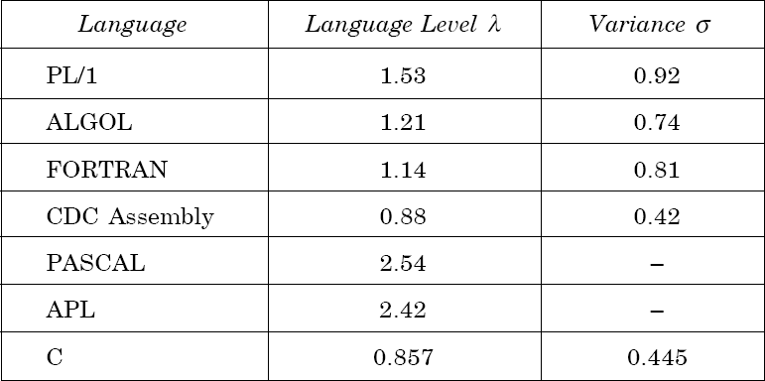
Software Metrics
Table 1: Language levels

Slide 21
Software Metrics
Counting rules for C language
Comments are not considered.
The identifier and function declarations are not considered.
All the variables and constants are considered operands.
Global variables used in different modules of the same program are counted as multiple occurrences of the same variable.

Slide 22
Software Metrics
Local variables with the same name in different functions are counted as unique operands.
Functions calls are considered as operators.
All looping statements e.g., do {…} while ( ), while ( ) {…}, for ( )
{…}, all control statements e.g., if ( ) {…}, if ( ) {…} else {…}, etc. are considered as operators.
In control construct switch ( ) {case:…}, switch as well as all the case statements are considered as operators.

Slide 23
Software Metrics
The reserve words like return, default, continue, break, sizeof, etc., are considered as operators.
All the brackets, commas, and terminators are considered as operators.
GOTO is counted as an operator and the label is counted as an operand.
The unary and binary occurrence of “+” and “-” are dealt separately. Similarly “*” (multiplication operator) are dealt with separately.

Slide 24
Software Metrics
In the array variables such as “array-name [index]” “array- name” and “index” are considered as operands and [ ] is considered as operator.
In the structure variables such as “struct-name, member-name” or “struct-name -> member-name”, struct-name, member-name are taken as operands and ‘.’, ‘->’ are taken as operators. Some names of member elements in different structure variables are counted as unique operands.
All the hash directive are ignored.

Slide 25
int sort (int x[ ], int n)
{
int i, j, save, im1;
/*This function sorts array x in ascending order */
If (n< 2) return 1;
for (i=2; i< =n; i++)
{ im1=i-1;
for (j=1; j< =im1; j++)
if (x[i] < x[j])
{
Save = x[i];
x[i] = x[j];
x[j] = save;
}
} return 0;
}

Slide 26
operators | occurrences | operands | occurrences
int | 4 | sort | 1
() | 5 | x | 7
, | 4 | n | 3
[] | 7 | i | 8
if | 2 | j | 7
< | 2 | save | 3
; | 11 | im1 | 3
for | 2 | 2 | 2
= | 6 | 1 | 3
– | 1 | 0 | 1
<= | 2 | – | –
++ | 2 | – | –
return | 2 | – | –
{} | 3 | – | –
n1=14 | N1=53 | n2=10 | N2=38

Slide 27
Therefore,
N = 91
n = 24
V = 417.23 bits
N^ = 86.51
n2* = 3 (x:array holding integer
to be sorted. This is used both
as input and output)
V* = 11.6
L = 0.027
D = 37.03
L^ = 0.038
T = 610 seconds

Slide 28
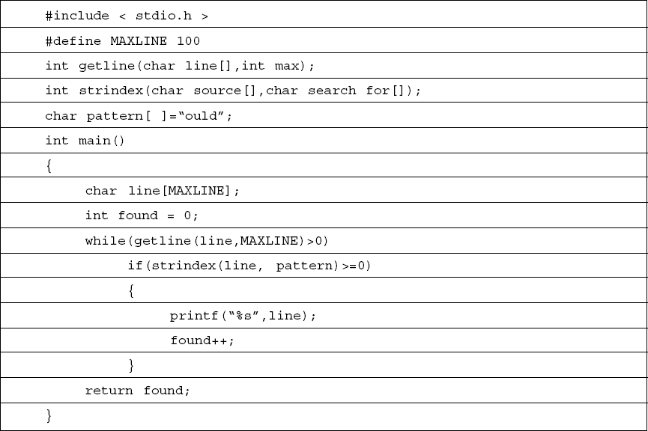
Software Metrics
Table 3
Software Engineering (3rd ed.), By K.K Aggarwal & Yogesh Singh, Copyright © New Age International Publishers, 2007

Slide 29
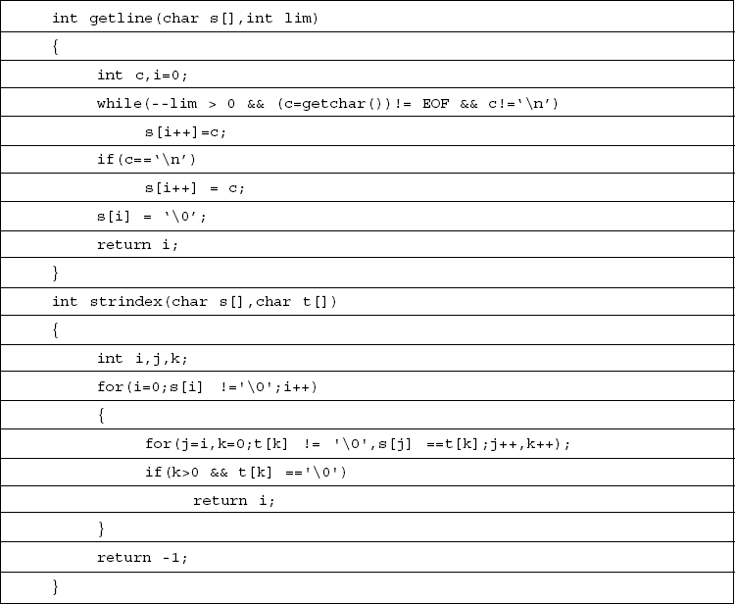
Software Metrics
Table 3
Software Engineering (3rd ed.), By K.K Aggarwal & Yogesh Singh, Copyright © New Age International Publishers, 2007

Slide 30
Software Metrics
Example- 6.2
Consider the program shown software science metrics.
in Table 3. Calculate the various

Slide 31
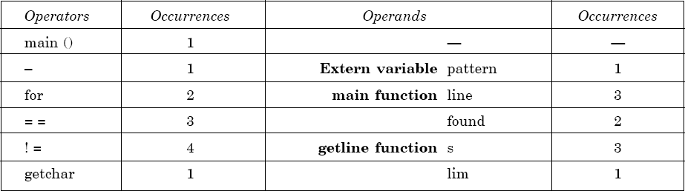
Software Metrics
Solution
List of operators and operands are given in Table 4.
Table 4

Slide 32
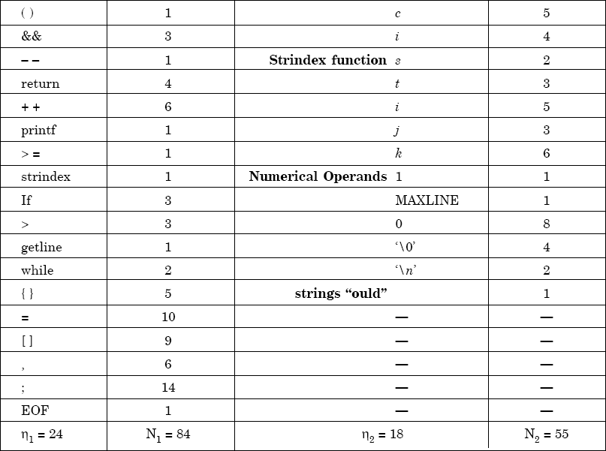
Software Metrics
Table 5

Slide 33
Software Metrics
Program vocabulary η = 42
N = N₁ +N₂
= 84 + 55 = 139
∧
N = 24 log₂ 24 +18 log₂ 18 = 185.115
= 24.91
V = 749.605 bits
Program length
Estimated length
% error
Program volume
₌ 2 × η₂
Estimated program level
η₁ N₂
= ² × ¹⁸ = 0.02727
24 55

Slide 34
Software Metrics
Minimal volume
V*=20.4417
∧
= V / L
₌ 748.605
Effort
.02727
= 27488.33 elementary mental discriminations.
27488.33
Time T =
E / β =
18
= 1527.1295 seconds
= 25.452 minutes

Slide 35
Software Metrics
Information Flow Metrics
Component : Any element identified by decomposing a
(software) system into its constituent parts.
Cohesion : The degree to which a component
performs a single function.
Coupling : The term used to describe the degree of linkage between one component to others in the same system.

Slide 36
Software Metrics
The Basic Information Flow Model
Information Flow metrics are applied to the Components of a system design. Fig. 13 shows a fragment of such a design, and for component ‘A’ we can define three measures, but remember that these are the simplest models of IF.
‘FAN IN’ is simply a count of the number of other Components that can call, or pass control, to Component A.
‘FANOUT’ is the number of Components that are called by Component A.
This is derived from the first two by using the following formula. We will call this measure the INFORMATION FLOW index of Component A, abbreviated as IF(A).
IF(A) = [FAN IN(A) x FAN OUT (A)]²

Slide 37
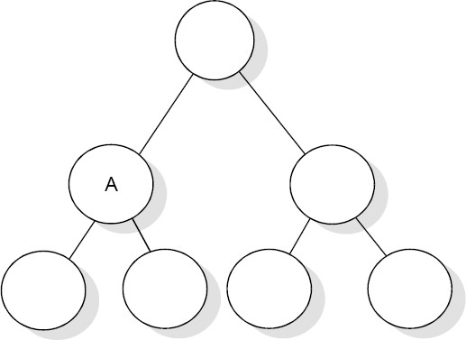
Software Metrics
Fig.13: Aspects of complexity

Slide 38
Software Metrics
The following is a step-by-step guide to deriving these most simple of IF metrics.
Note the level of each Component in the system design.
For each Component, count the number of calls so that Component – this is the FAN IN of that Component. Some organizations allow more than one Component at the highest level in the design, so for Components at the highest level which should have a FAN IN of zero, assign a FAN IN of one. Also note that a simple model of FAN IN can penalize reused Components.
For each Component, count the number of calls from the Component. For Component that call no other, assign a FAN OUT value of one.
cont…

Slide 39
Software Metrics
Calculate the IF value for each Component using the above formula.
Sum the IF value for all Components within each level which is called as the LEVEL SUM.
Sum the IF values for the total system design which is called the SYSTEM SUM.
For each level, rank the Component in that level according to FAN IN, FAN OUT and IF values. Three histograms or line plots should be prepared for each level.
Plot the LEVEL SUM values for each level using a histogram or line plot.

Slide 40
Software Metrics
A More Sophisticated Information Flow Model
a = the number of components that call A.
b = the number of parameters passed to A from components higher in the hierarchy.
c = the number of parameters passed to A from components lower in the hierarchy.
d = the number of data elements read by component A.
Then:
FAN IN(A)= a + b + c + d

Slide 41
Software Metrics
Also let:
e = the number of components called by A;
f = the number of parameters passed from A to components in the hierarchy;
higher
g = the number of parameters passed from A to components lower in the hierarchy;
h = the number of data elements written to by A.
Then:
FAN OUT(A)= e + f + g + h

